Slide 1
Appendix B: Advanced Relational Database Design

Slide 2
Appendix B: Advanced Relational Database Design
Reasoning with MVDs
Higher normal forms
  Join dependencies and PJNF
  DKNF

Slide 3
Theory of Multivalued Dependencies
Let D denote a set of functional and multivalued dependencies. The closure D⁺ of D is the set of all functional and multivalued dependencies logically implied by D.
Sound and complete inference rules for functional and multivalued dependencies:
1. Reflexivity rule. If α is a set of attributes and β ⊆ α, then α →β holds.
2. Augmentation rule. If α → β holds and γ is a set of attributes,
then γ α→γ β holds.
3. Transitivity rule. If α → β holds and β →γ holds, then α →γ holds.

Slide 4
Theory of Multivalued Dependencies (Cont.)
  4. Complementation rule. If α β holds, then α R – β – α holds.
  5. Multivalued augmentation rule. If α β holds and γ ⊆ R and δ ⊆ γ, then γ α δ β holds.
  6. Multivalued transitivity rule. If α β holds and β γ holds, then α γ – β holds.
  7. Replication rule. If α β holds, then α β.
  8. Coalescence rule. If α β holds and γ ⊆ β and there is a δ such that δ ⊆ R and δ ∩ β = ∅ and δ γ, then α γ holds.

Slide 5
Simplification of the Computation of D⁺
We can simplify the computation of the closure of D by using the following rules (proved using rules 1-8).
  Multivalued union rule. If α β holds and α γ holds, then
  α βγ holds.
  Intersection rule. If α β holds and α γ holds, then α β ∩ γ holds.
  Difference rule. If If α β holds and α γ holds, then α β – γ holds and α γ – β holds.

Slide 6
Example
R = (A, B, C, G, H, I)
D = {A B
B HI
CG H}
Some members of D⁺:
  A CGHI.
  Since A B, the complementation rule (4) implies that A R – B – A.
  Since R – B – A = CGHI, so A CGHI.
  A HI.
  Since A B and B HI, the multivalued transitivity rule (6) implies that B HI – B.
  Since HI – B = HI, A HI.

Slide 7
Example (Cont.)
Some members of D⁺ (cont.):
  B H.
  Apply the coalescence rule (8); B HI holds.
  Since H ⊆ HI and CG H and CG ∩ HI = Ø, the
  coalescence rule is satisfied with α being B, β being HI, δ being CG, and γ being H. We conclude that B H.
  A CG.
  A CGHI and A HI.
  By the difference rule, A CGHI – HI.
  Since CGHI – HI = CG, A CG.

Slide 8
Normalization Using Join Dependencies
Join dependencies constrain the set of legal relations over a schema R to those relations for which a given decomposition is a lossless-join decomposition.
Let R be a relation schema and R₁ , R₂ ,..., R_{n} be a decomposition of R. If R = R₁ ∪ R₂ ∪ …. ∪ R_{n}, we say that a relation r(R) satisfies the join dependency *(R₁ , R₂ ,..., R_{n}) if:
r =∏_{R1} (r) ⋈ ∏_{R2} (r) ⋈ …… ⋈ ∏_{Rn}(r)
A join dependency is trivial if one of the R_{i} is R itself.
A join dependency *(R₁, R₂) is equivalent to the multivalued dependency R₁ ∩ R₂ R₂. Conversely, α β is equivalent to *(α ∪(R - β), α ∪ β)
However, there are join dependencies that are not equivalent to any multivalued dependency.

Slide 9
Project-Join Normal Form (PJNF)
A relation schema R is in PJNF with respect to a set D of functional, multivalued, and join dependencies if for all join dependencies in D⁺ of the form
  *(R₁ , R₂ ,..., R_{n} ) where each R_{i} ⊆ R
  and R =R₁∪ R₂ ∪ ... ∪ R_{n}
at least one of the following holds:
  *(R₁ , R₂ ,..., R_{n} ) is a trivial join dependency.
  Every R_{i} is a superkey for R.
Since every multivalued dependency is also a join dependency,
every PJNF schema is also in 4NF.

Slide 10
Example
Consider Loan-info-schema = (branch-name, customer-name, loan-number, amount).
Each loan has one or more customers, is in one or more branches and has a loan amount; these relationships are independent, hence we have the join dependency
*(=(loan-number, branch-name), (loan-number, customer-name), (loan-number, amount))
Loan-info-schema is not in PJNF with respect to the set of dependencies containing the above join dependency. To put Loan-info-schema into PJNF, we must decompose it into the three schemas specified by the join dependency:
  (loan-number, branch-name)
  (loan-number, customer-name)
  (loan-number, amount)

Slide 11
Domain-Key Normal Form (DKNY)
Domain declaration. Let A be an attribute, and let dom be a set of values. The domain declaration A ⊆ dom requires that the A value of all tuples be values in dom.
Key declaration. Let R be a relation schema with K ⊆ R. The key declaration key (K) requires that K be a superkey for schema R (K → R). All key declarations are functional dependencies but not all functional dependencies are key declarations.
General constraint. A general constraint is a predicate on the set of all relations on a given schema.
Let D be a set of domain constraints and let K be a set of key constraints for a relation schema R. Let G denote the general constraints for R. Schema R is in DKNF if D ∪ K logically imply G.

Slide 12
Example
Accounts whose account-number begins with the digit 9 are special high-interest accounts with a minimum balance of 2500.
General constraint: ``If the first digit of t [account-number] is 9, then t [balance] ≥ 2500.''
DKNF design:
  Regular-acct-schema = (branch-name, account-number, balance)
  Special-acct-schema = (branch-name, account-number, balance)
Domain constraints for {Special-acct-schema} require that for each account:
  The account number begins with 9.
  The balance is greater than 2500.

Slide 13
DKNF rephrasing of PJNF Definition
Let R = (A₁ , A₂ ,..., A_{n}) be a relation schema. Let dom(A_{i} ) denote the domain of attribute A_{i}, and let all these domains be infinite. Then all domain constraints D are of the form A_{i} ⊆ dom (A_{i} ).
Let the general constraints be a set G of functional, multivalued, or join dependencies. If F is the set of functional dependencies in G, let the set K of key constraints be those nontrivial functional dependencies in F⁺ of the form α → R.
Schema R is in PJNF if and only if it is in DKNF with respect to D, K, and G.

Slide 14
End of Appendix B

Slide 15
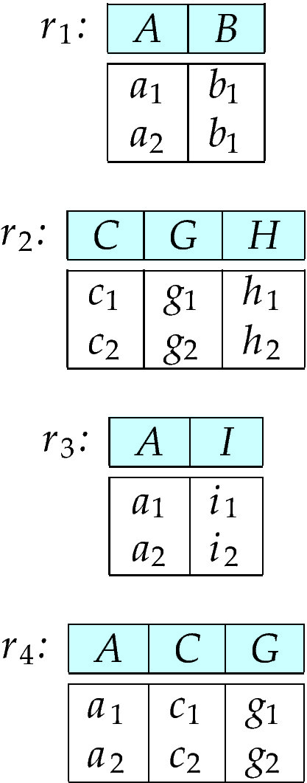
Figure B.01

Slide 16
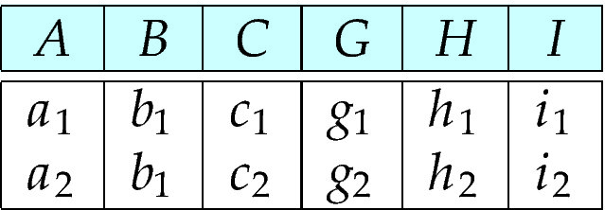
Figure B.02

Slide 17
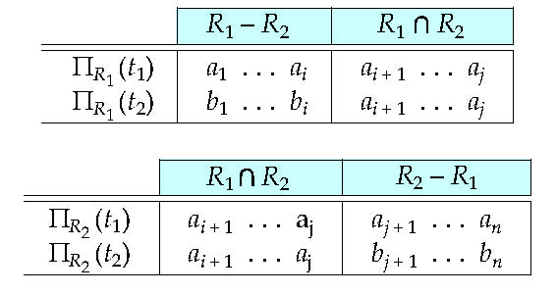
Figure B.03

Slide 18
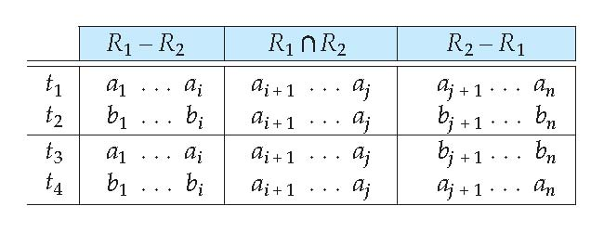
Figure B.04

Slide 19
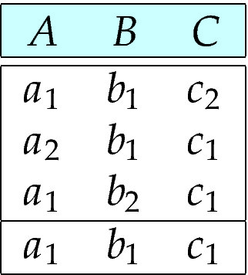
Figure B.05

Slide 20
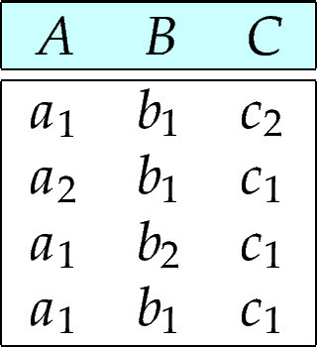
Figure B.06

Slide 21
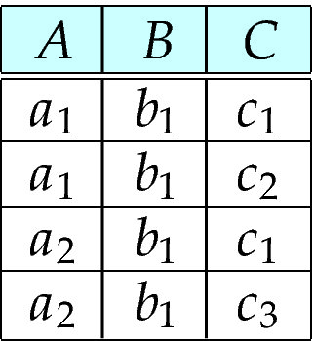
Figure B.07

